Slide 1
Operating System services

Slide 2
Operating System Services
Operating systems provide an environment for the execution of programs and services to programs and users
One set of operating-system services provides functions that are helpful to the user
User interface
Program execution- The system must be able to load a program into memory and run that program, end it,
I/O operations - A running program may require I/O, which may involve a file or an I/O device.
File-system manipulation - Programs need to read and write files and directories, create and delete them, search them, list file Information, and permission management.
Communications – facilities to exchange information between processes residing on the same or different computer
Error detection – Debugging facilities should be there

Slide 3
Operating System Services(Contd..)
Another set of OS functions exists for ensuring the efficient operation of the system itself via resource sharing
Resource allocation – When multiple users or multiple jobs running concurrently, resources must be allocated to each of them.
Resources like - CPU, main memory, file storage, and I/O devices.
Accounting - To keep track of which users use how much & what kinds of computer resources.
Protection and security - The owners of information stored in a multi-user or networked computer system may want to control the use of that information, concurrent processes should not interfere with each other
Protection ensuring all access to system resources is controlled
Security requires user authentication, and extends to defending external I/O devices from invalid access attempts

Slide 4
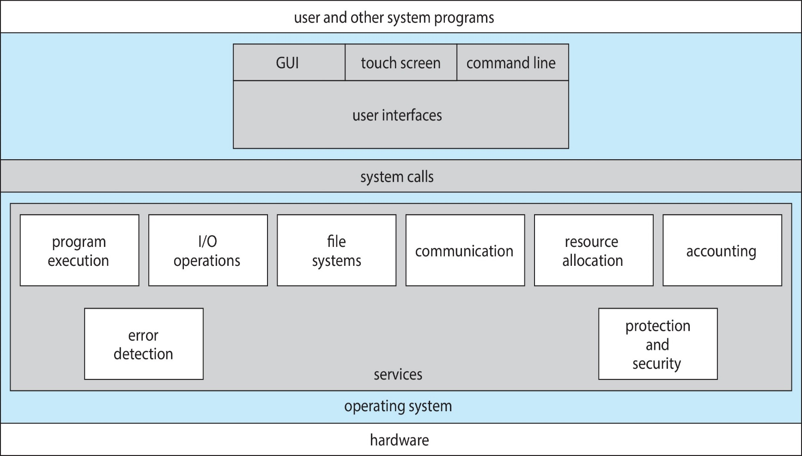
A View of Operating System Services

Slide 5
System calls
System calls are programming interfaces provided by an operating system to allow user-level processes to request services from the operating system kernel.
Typically written in a high-level language (C or C++).
Kernal services are mostly accessed by programs via a high-level Application Programming Interface (API) rather than a direct system call.
Three most common APIs are
Win32 API for Windows
POSIX API for POSIX-based systems(UNIX, Linux, and Mac OS X),
Java API for the Java virtual machine (JVM)

Slide 6
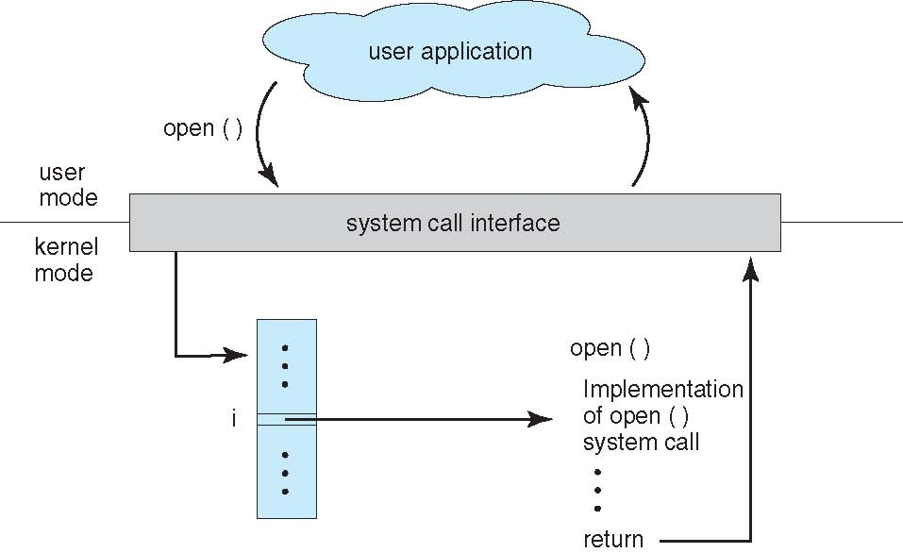
API – System Call – OS Relationship

Slide 7
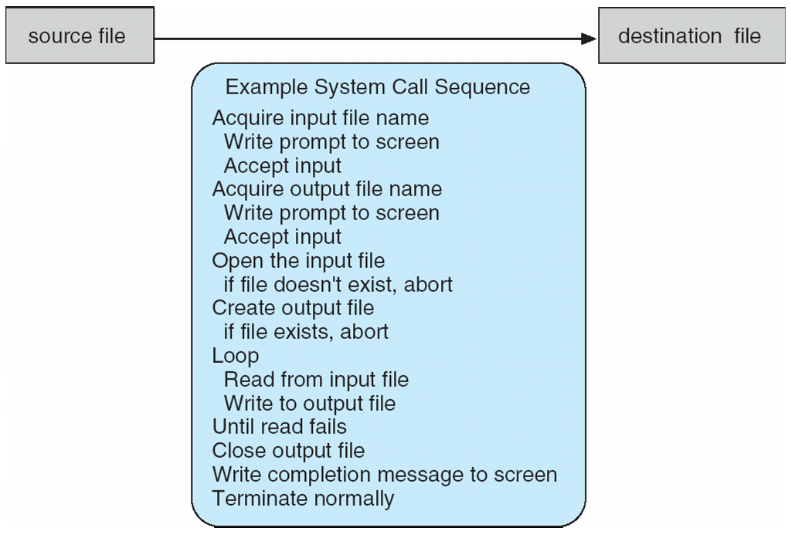
Example of System call
System call to copy the contents of one file to another

Slide 8
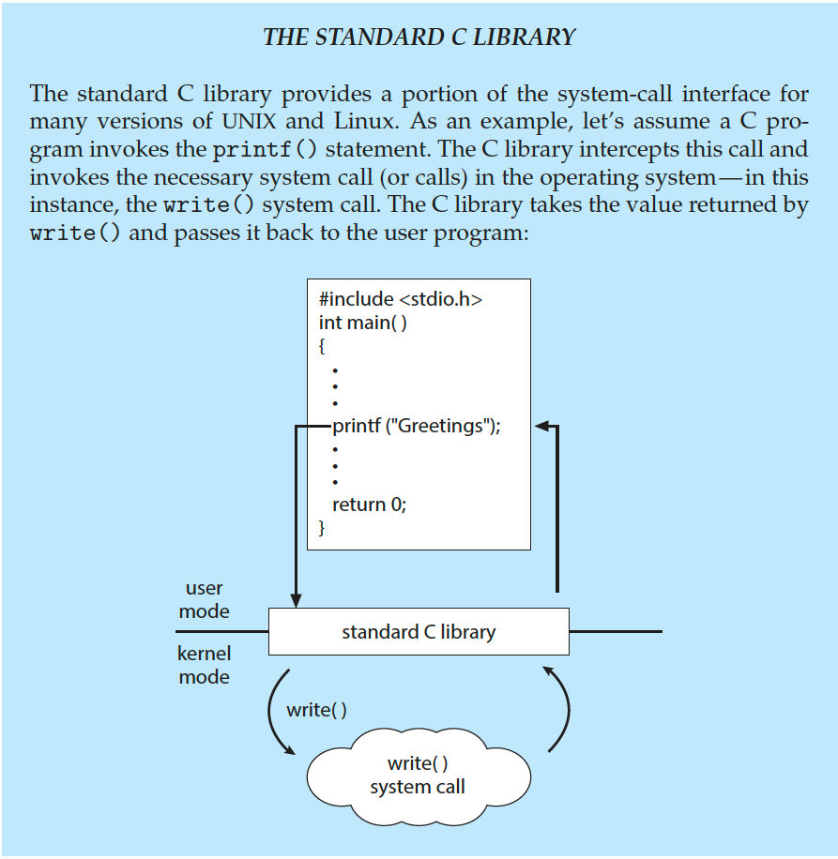
Standard c library example
C program invoking printf() library call,
which calls write() system call

Slide 9
Types of system calls
Process control
Create process, terminate process
End, abort
Load, execute
Get process attributes, set process attributes
Wait for time
Wait event, signal event
Allocate and free memory
Dump memory if error
Debugger for determining bugs, single step execution
Locks for managing access to shared data between processes.

Slide 10
Types of system calls(contd..)
File management
create file, delete file
open, close file
read, write, reposition
get and set file attributes
Device management
request device, release device
read, write, reposition
get device attributes, set device attributes
logically attach or detach devices

Slide 11
Types of system calls(contd..)
Information Maintenance
get time or date, set time or date
get system data, set system data
get and set process, file, or device attributes
Communications
create, delete communication connection
send, receive messages if message passing model to host name or process name
From client to server
Shared-memory model create and gains access to memory regions
transfer status information
attach and detach remote devices

Slide 12
Types of system calls (contd..)
Protection
Control access to resources
Get and set permissions
Allow and deny user access

Slide 13
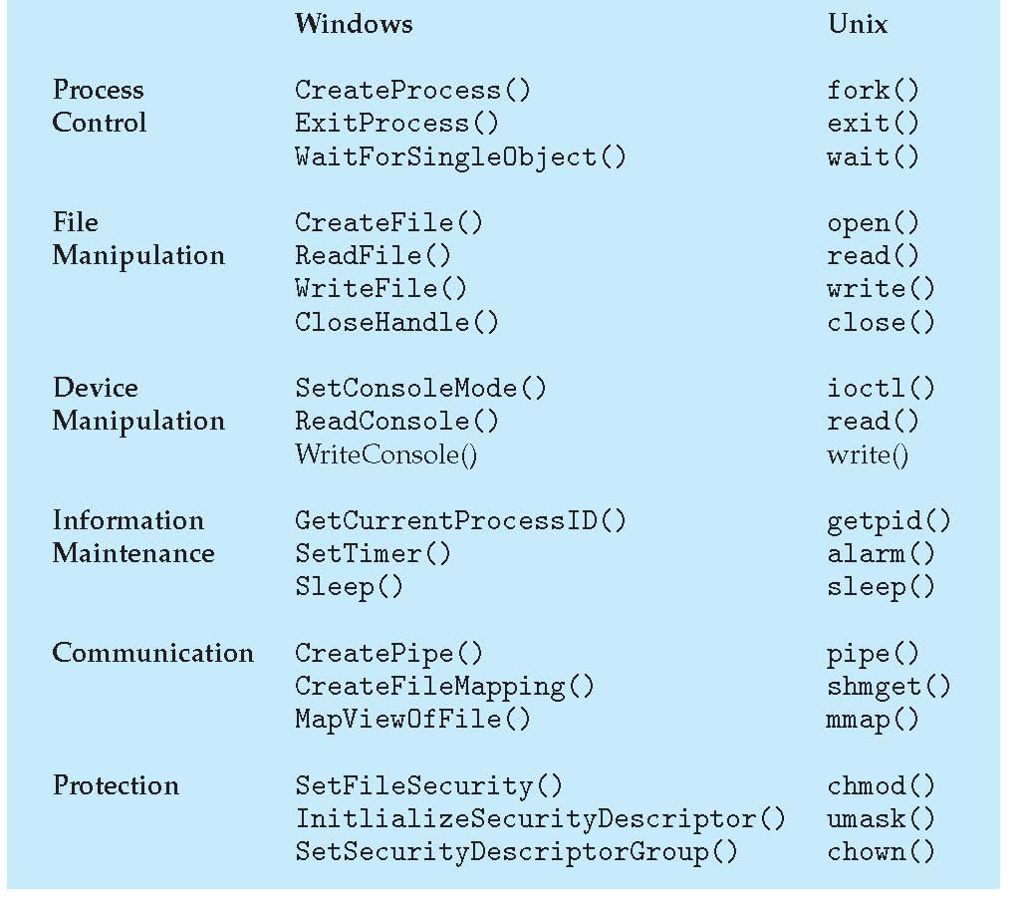
Example of windows and linux system calls

Slide 14
System booting
Upon power initialized on the system, execution starts at a fixed memory location
Firmware used to hold the initial boot code
Operating system must be made available to hardware
Small piece of code – bootstrap loader, stored in ROM or EEPROM locates the kernel, loads it into memory, and starts it
Sometimes two-step process where the boot block at a fixed location is loaded by ROM code, which loads the bootstrap loader from the disk
Common bootstrap loader, GRUB, allows selection of kernel from multiple disks, versions, kernel options
Kernel loads and the system will then start working.

Slide 15
Summary
OS Services
System Calls
Types of System Calls
System Booting

